Slide 1
Game Design Masterclass Group 9
Douglas Simpson, Thomas Simmons, Quwaine Dantes, Callam Mutton

Slide 2
The Brief
The brief given is to create a 2d game for a mobile platform.
It must be multiplayer, and controlled via a single button press.
It must be symmetric, with both players having the same options and controls.
It can be simultaneous or turn based.

Slide 3
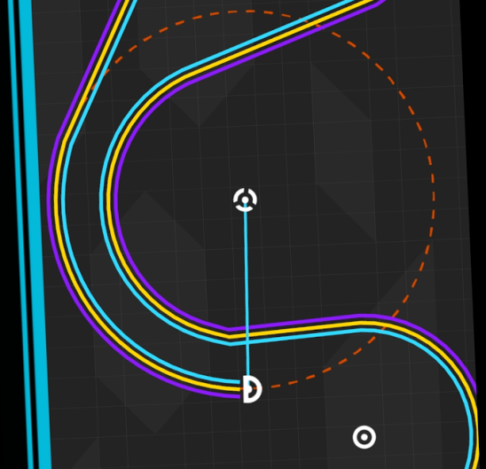
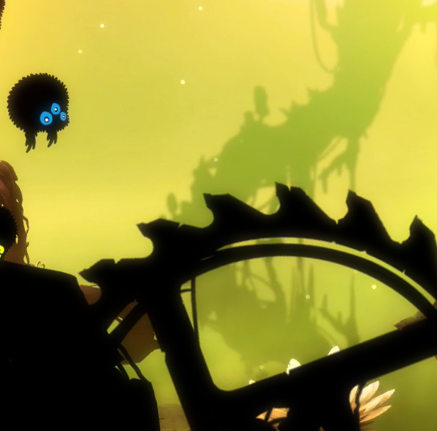
Research
Having looked at the example games along with several others, we gathered some on how a single button input can be used:
One More Line
Uses the tap as a toggle while held
Holding it causes the user to lock on to something nearby
This changes their path since they are always moving
Badland / 2:
Uses single taps
When tapped, the players move upwards, otherwise they fall
Tapping directly counters normal movement

Slide 4

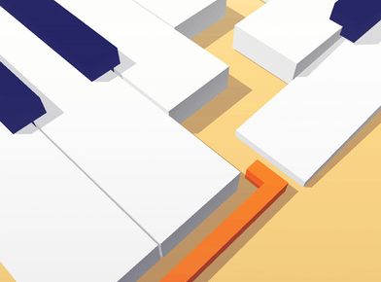
Research
Stack
Uses single taps
Timing the button press is the main focus
Poor performance makes the game become more difficult
Dancing Line
Single taps to a rythm
The rythm is set by the visuals and audio

Slide 5
Game Ideas
Roulette Fighter
2d fighting game with spinning control wheel
Gravity Line
Downhill race using gravity to swing the players around
Sub Game
Submarine battle focusing on vertical movement and evasion

Slide 6
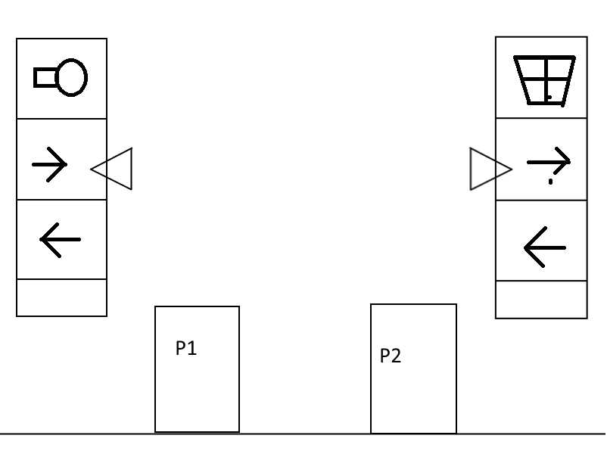
Roulette Fighter
Simultaneous
A simple 2d fighting game
Moves are selected by stopping a spinning wheel-Thus the game would be timing and skill based.
Possible casino theme for the visuals
Core Loop: Wheel spins, Player selects move, move resolves
Hard Fun/People Fun

Slide 7
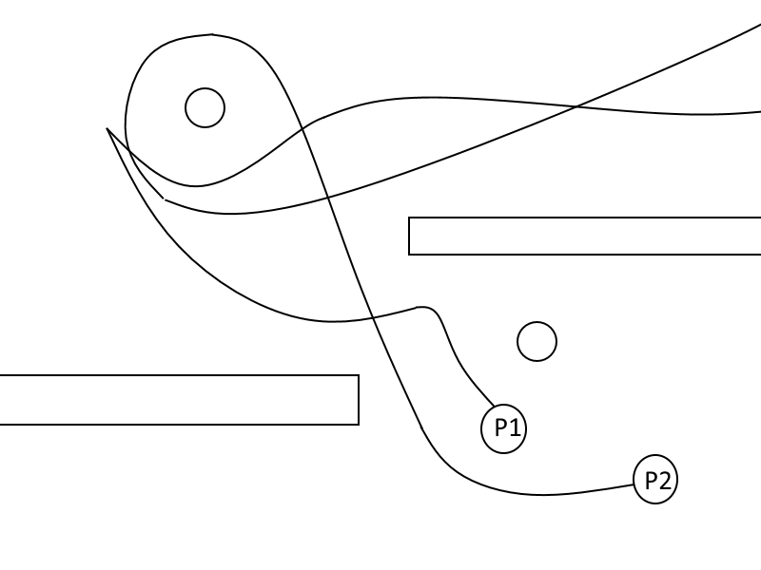
Gravity Line
Simultanious
Heavily inspired by One More Line
Gravity would be used to direct the swinging players
Would be a downhill race, with players gaining points by getting far enough ahead of their opponent
Core Loop: Player falls, Player connects and swings, Player releases
Hard Fun/Serious Fun/People fun

Slide 8
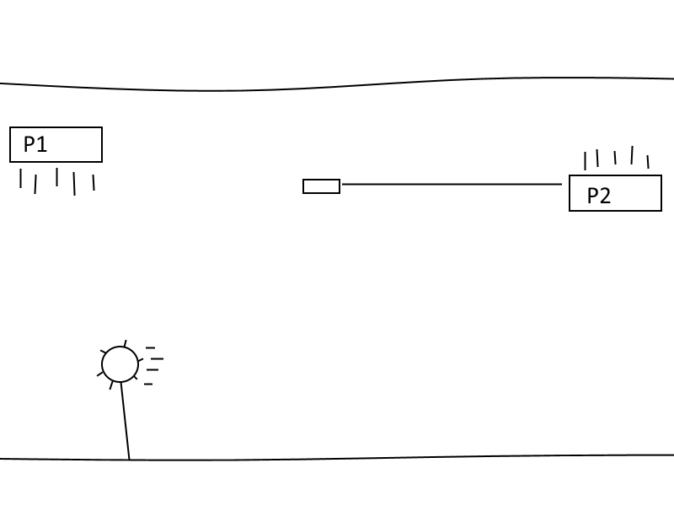
Sub Game
Simultaneous
Each player controls a submarine
Tapping and holding causes the player’s sub to dive
Releasing causes it to fire a torpedo across the screen
Various obstacles such as seaweed, naval mines ect.
Core Loop: Player taps to position themselves, Torpedoes are launched, Players attempt to evade.
Hard fun/People fun

Slide 9
Chosen Idea
We’ve chosen to go with the Sub Game
Should be possible to put together in the limited time for the project and team skillset.
Lots of flexibility for obstacles and possible alternate submarines.
We will be creating it in Unreal 4

Slide 10
Any Questions?

